Slide 1


ARVIO ANANDI
BANK CUSTOMER CHURN ANALYSIS

Slide 2


TABLE OF CONTENTS
Executive Summary
Introduction
Data Wrangling
EDA
Data Visualization
Key Findings and Insights
Conclusion & Recommendations

Slide 3
EXECUTIVE SUMMARY

Slide 4
BUSINESS BACKGROUND
I've taken on the role of a freelance data analyst, partnering with a prominent EU bank. This bank is renowned for its extensive customer base and innovative financial solutions. Their aim is simple yet crucial: reduce customer churn. The challenge is to understand why customers are leaving and devise modest, effective solutions to retain them. This project is about enhancing customer experiences and fostering loyalty, all while staying true to the bank's values and reputation.

Slide 5
BUSINESS OBJECTIVES
The core objectives of this analysis project are to uncover why customers are leaving the bank, pinpoint which customer segments are most at risk of churn, and provide actionable strategies to retain customers while enhancing overall satisfaction. This project strives to strengthen customer relationships, reduce churn rates, and empower data-driven decision-making within the bank.

Slide 6

OUTPUT
The output of this project is a dashboard to visualize the customer churn data

Slide 7
INTRODUCTION

Slide 8

DATA SOURCE
The dataset was acquired from Kaggle, with 10000 rows and 18 columns.

Slide 9
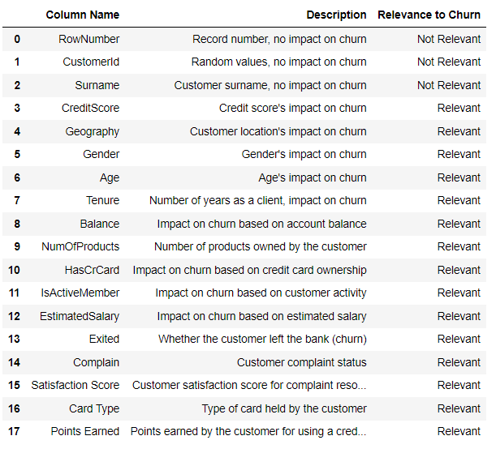
COLUMN EXPLANATION

Slide 10
DATA WRANGLING

Slide 11

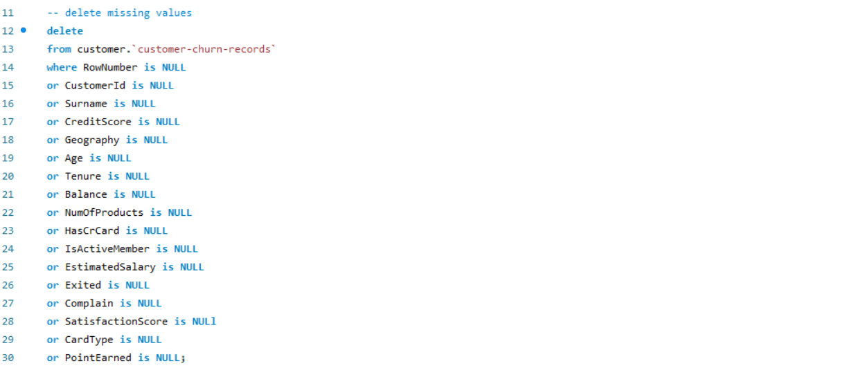
Removed missing values

Slide 12
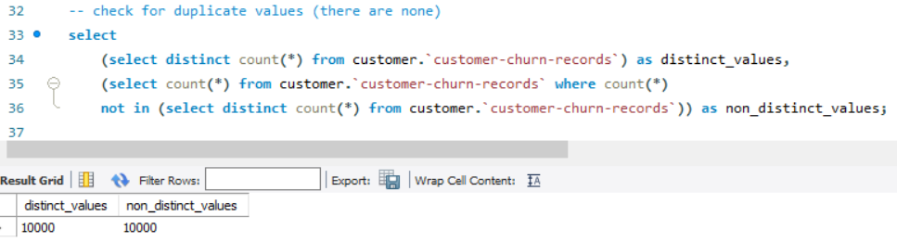
There seems to be no duplicates as the distinct values and non distinct value comparison is the same

Slide 13
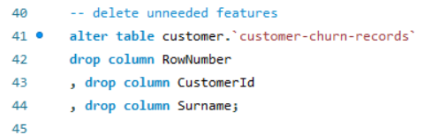
Delete unneeded features which are rownumber, customer id, and surname as they don’t contribute much to this project.

Slide 14
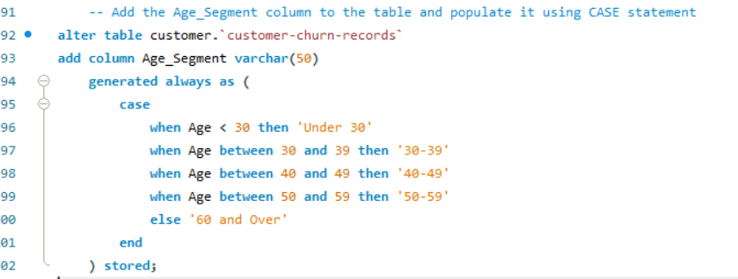
Feature engineer a new feature called Age_segment to segment the age groups to 5 groups (Under 30, 30-39, 40-49, 50-59, and 60 and Over).

Slide 15
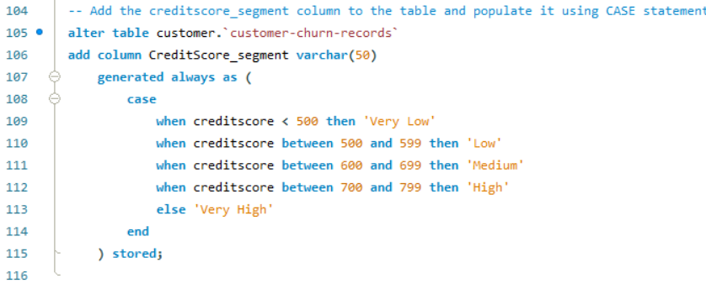
Feature engineer a new feature called Creditscore_segment to segment the CreditScore to group of 5 categories (Very Low, Low, Medium, High, and Very High).

Slide 16
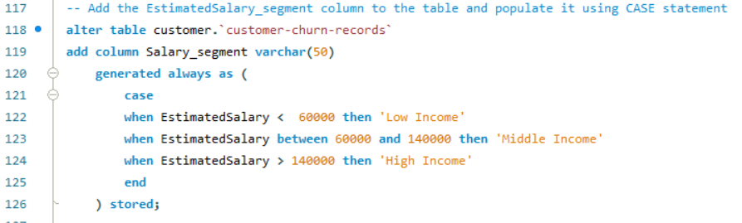
Feature engineered a new feature called Salary_segment to segment the Salary to groups of 3 categories (Low Income, Middle Income, and High Income).

Slide 17
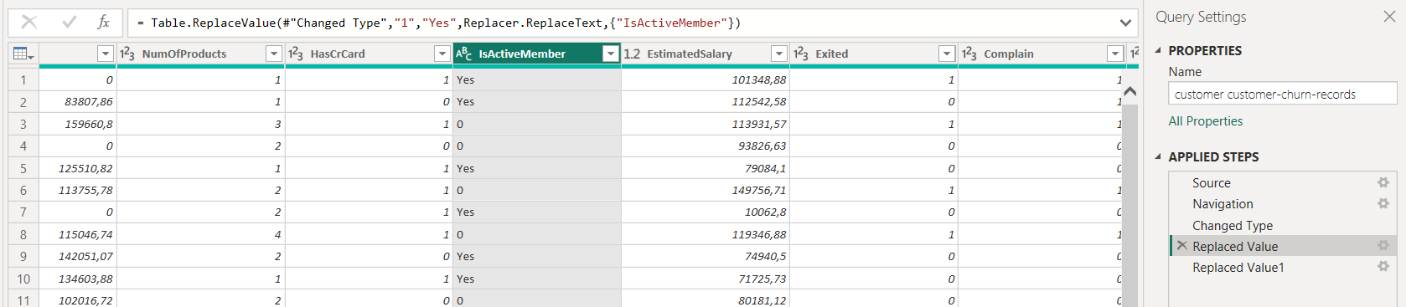
In Power BI, using the Power Query Transform, i changed the values of column IsActiveMember from 1 and 0s to Yes and No. This was done to create clearer labels for visualization later.

Slide 18
EXPLORATORY DATA ANALYSIS

Slide 19
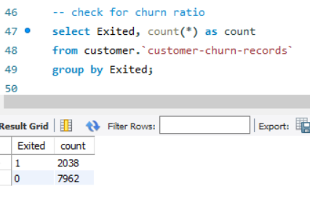
This table shows that there seems to be data imbalance for churned and not churned customers. This explains that roughly 80% of customers chose not to churn from the bank.

Slide 20
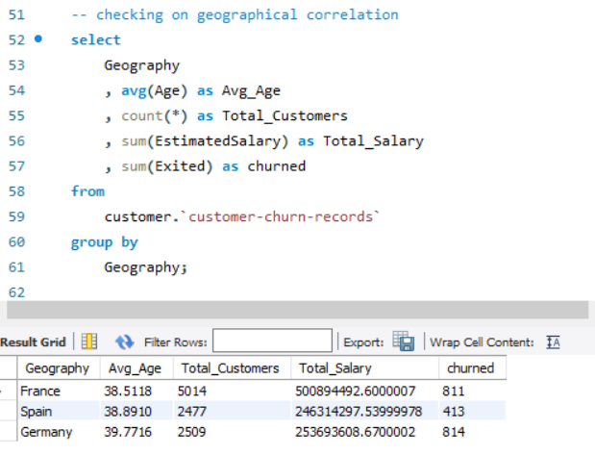
The table shows the distribution of churned customers from different countries. This tells us that people from France and Germany are more likely to churn than people from Spain.

Slide 21
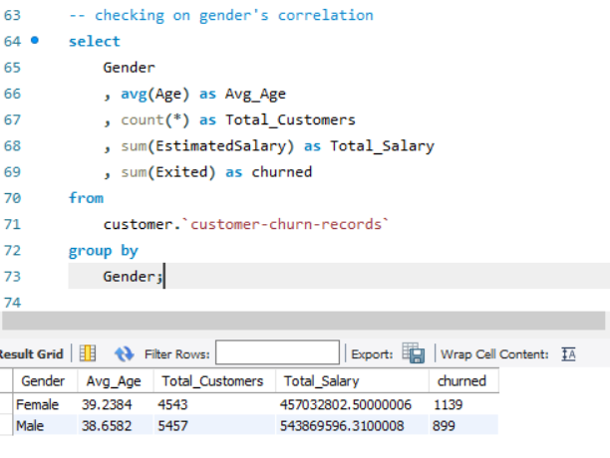
From the given dataset, female customers tend to churn more than male customers. This could provide some insights and be explored further.

Slide 22
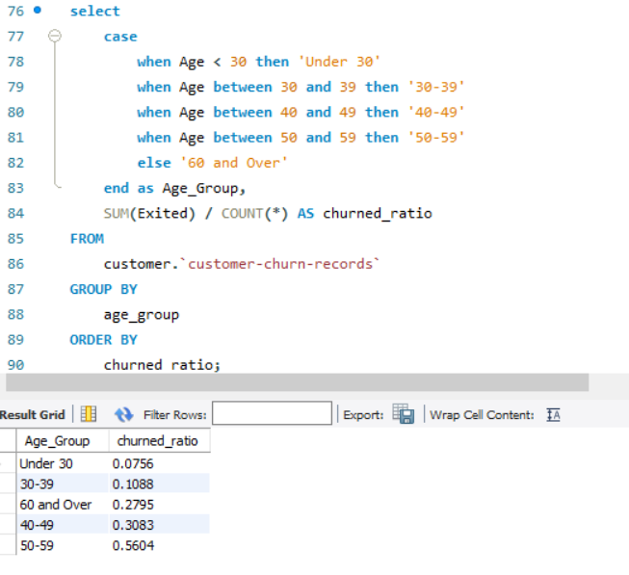
People from the youngest and oldest group of age have a fair share for not churning. For the young group, this could be explained by their digitalized environment where information are easily consumed which explains their financial literacy that helps to determine their long-term bank decisions whereas for the seniors, this could be explained by a more stable financial decisions, and their long-term relationships with banks which corresponds to them not switching banks

Slide 23
DATA VISUALIZATION

Slide 24
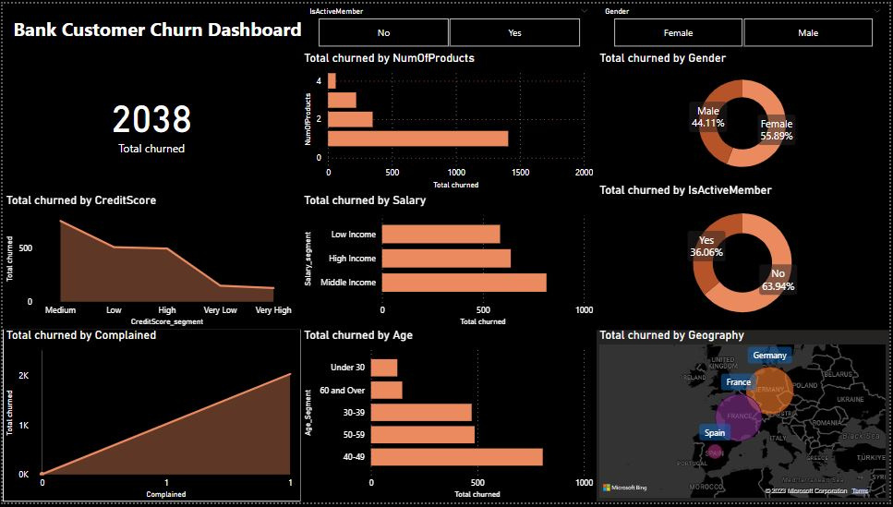

This dashboard is created using Microsoft Power BI and Power Query Transform. You can slice the data using the slicers provided. The two slicers was provided to avoid visualization misunderstandings.

Slide 25
KEY FINDINGS & INSIGHTS

Slide 26
Customers with very high and very low credit score tend not to churn.
Customers who rarely complain about bank products tend not to churn.
Customers who subscribes to more bank products tend not to churn.
Customers with Low and High Income tend not to churn.
The youngest and oldest group of customers tend not to churn.
Males are less likely to churn than females.
Active members are less likely to churn than non-active members.
Customers from Spain are less likely to churn than customers from Germany or France.

Slide 27
CONCLUSION & RECOMMENDATIONS

Slide 28
CONCLUSION
The analysis has provided valuable insights into customer churn patterns for the bank. Customers with extreme credit scores, low complaint frequency, higher product subscriptions, diverse income levels, and belonging to specific age groups, genders, or active member status are less likely to churn. Understanding these patterns is crucial because retaining existing customers is more cost-effective than acquiring new ones. Recognizing the factors that influence customer decisions to leave allows the bank to develop proactive strategies for churn prevention.

Slide 29
RECOMMENDATIONS
1. Tailored Loyalty Programs: Develop personalized loyalty programs based on customer segments. Offer incentives and rewards to high-churn-risk groups to encourage their loyalty.
2. Improved Customer Service: Enhance customer service, especially for customers who frequently complain. Swift and effective complaint resolution can significantly improve customer satisfaction and retention rates.
3. Product Bundling: Encourage customers to subscribe to multiple bank products by offering bundled services. Create packages that cater to various needs, providing an incentive for customers to stay.
4. Income-Adjusted Services: Customize services based on income levels. Offer financial products that align with the financial capacity of customers, ensuring affordability and value for money.
5. Age-Specific Engagement: Understand and address the unique requirements of different age groups. Develop age-specific products and services, ensuring relevance and appeal across generations.

Slide 30
RECOMMENDATIONS
6. Gender-Inclusive Services: Create banking services that address the specific needs of both genders. Recognize diverse financial goals and preferences, making the bank more inclusive.
7. Active Member Recognition: Acknowledge and reward active members. Offer exclusive services, discounts, or privileges to keep active members engaged and loyal.
8. Cultural Sensitivity: Recognize and respect cultural differences, especially for customers from different countries. Offer services that resonate with their cultural values, building trust and customer loyalt.
9. Regular Feedback Mechanism: Implement a systematic feedback system. Regularly collect feedback from customers to understand their evolving needs and concerns, allowing the bank to adapt its strategies accordingly.
10. Data-Driven Decisions: Invest in advanced analytics and AI tools to continually analyze customer behavior. Predictive models can identify potential churners early, allowing the bank to take proactive measures.

Slide 31



THANK YOU
CONTACTS
+6287764260779
arvioanandi@gmail.com
PROJECT LINK
Bank Customer Churn Analysis

